Slide 1
Compatibility Testing On Laptop Browsers

Slide 2
Website:- Thomascook.com
Thomas Cook (22 November 1808 – 18 July 1892) was an English businessman. He is best known for founding the travel agency Thomas Cook & Son. He was also one of the initial developers of the "package tour" including travel, accommodations, and the like.

Slide 3
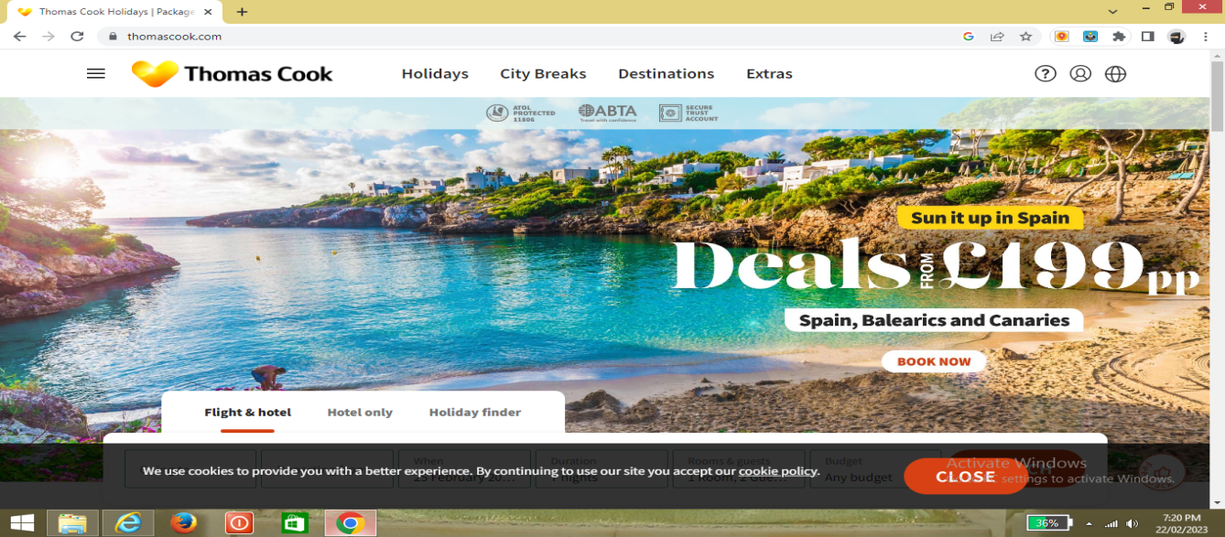

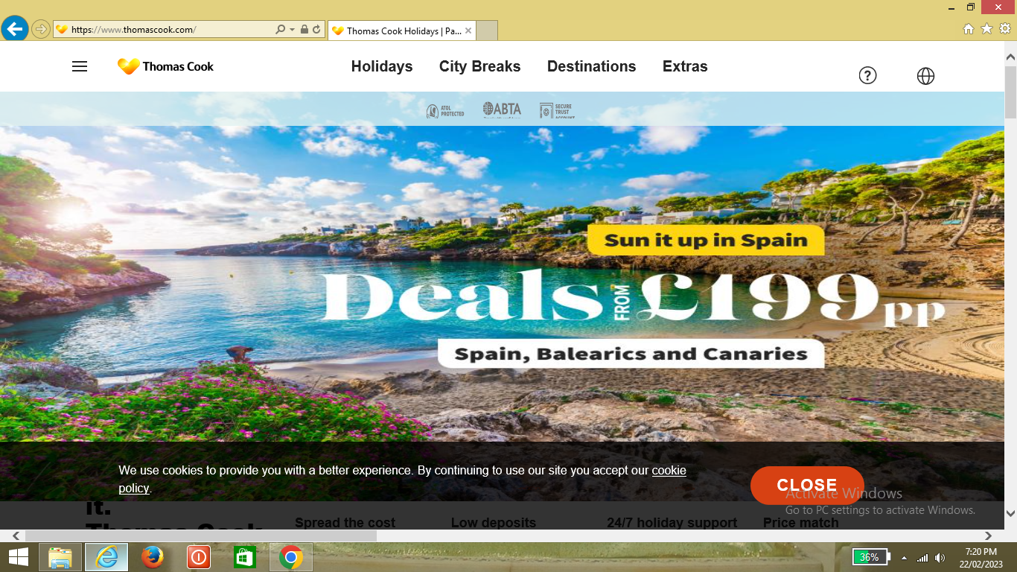
Laptop Browser:- Chrome & Internet Explorer
Chorme
Internet Explorer

Slide 4
Laptop Browser:- Chrome & Internet Explorer
Chorme
Internet Explorer

Slide 5
Laptop Browser:- Chrome & Internet Explorer
Chorme
Internet Explorer

Slide 6
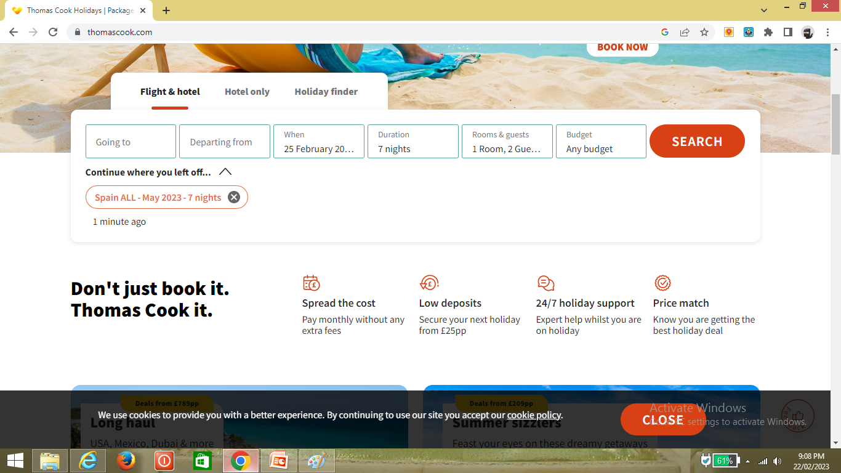
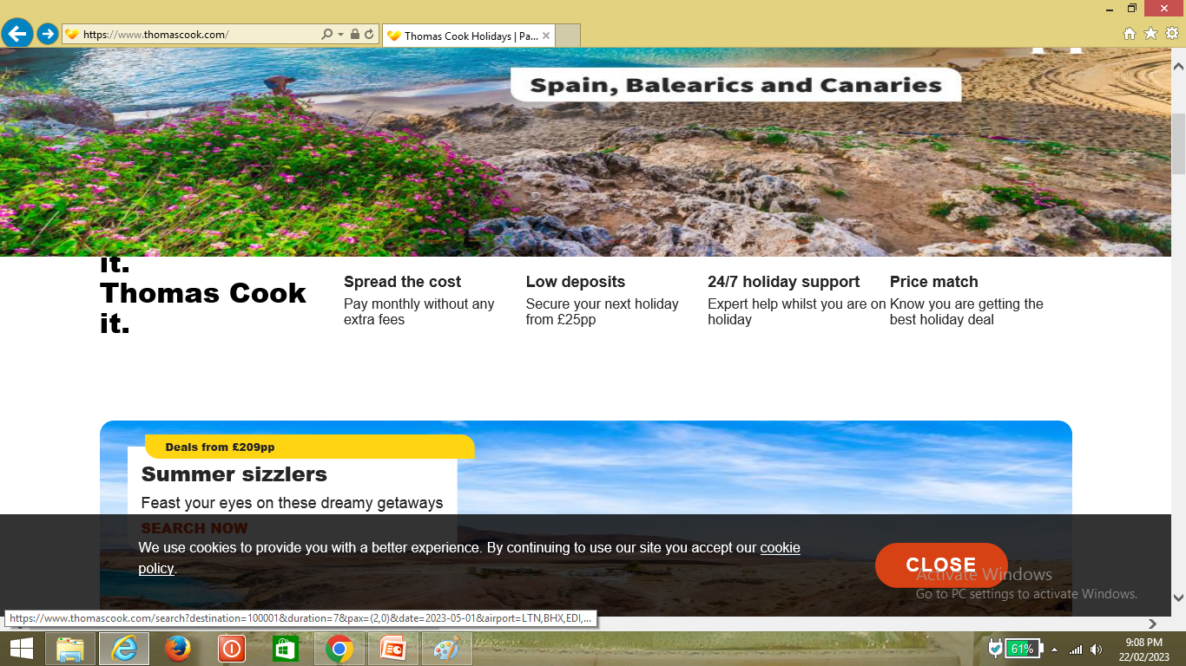
Laptop Browser:- Chrome & Internet Explorer
Chorme
Internet Explorer

Slide 7
Laptop Browser:- Chrome & Internet Explorer
Chorme
Internet Explorer

Slide 8
Laptop Browser:- Chrome & Internet Explorer
Chorme
Internet Explorer

Slide 9
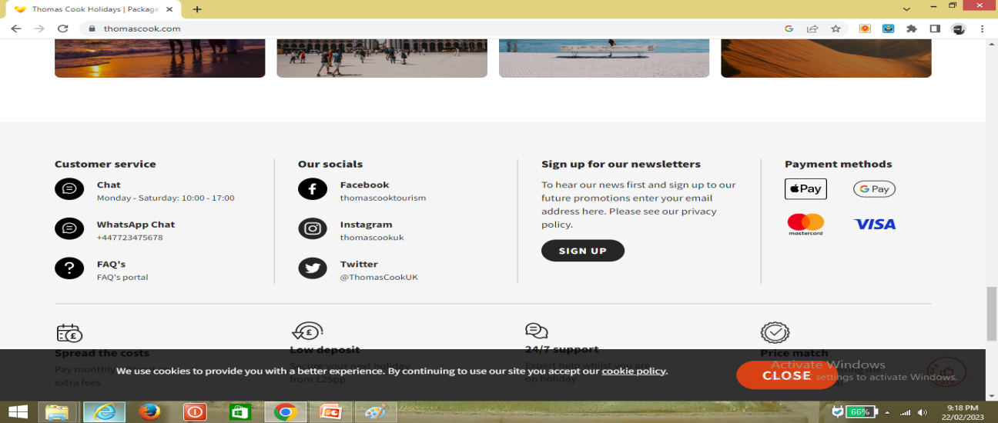
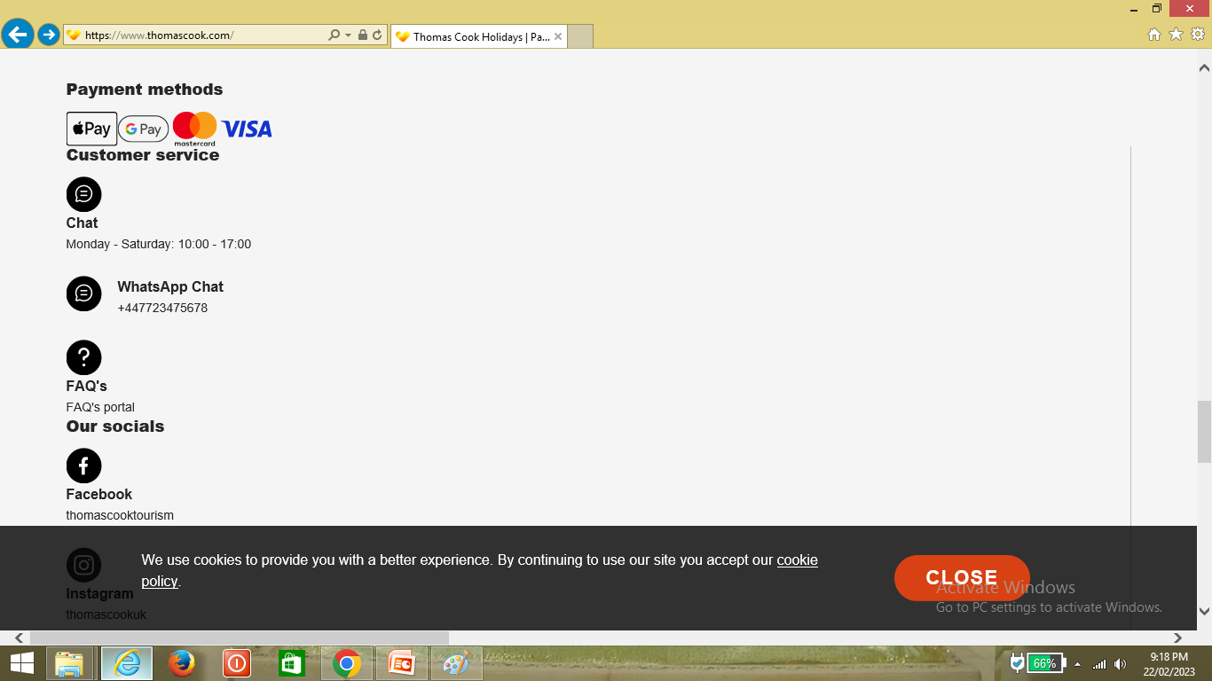
Laptop Browser:- Chrome & Internet Explorer
Chorme
Internet Explorer

Slide 10
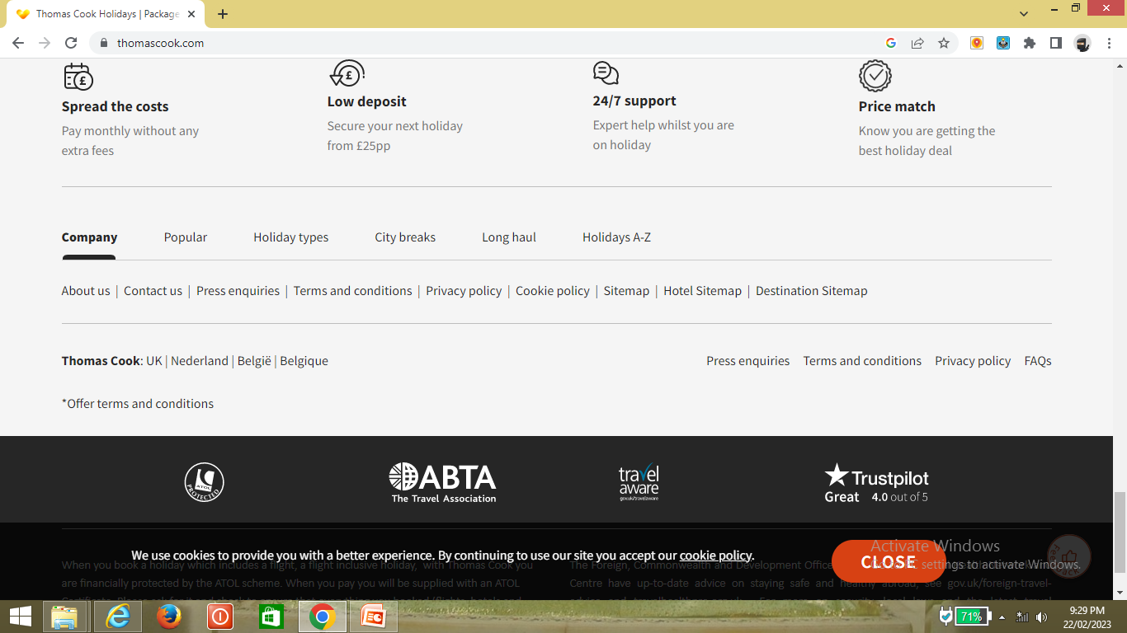
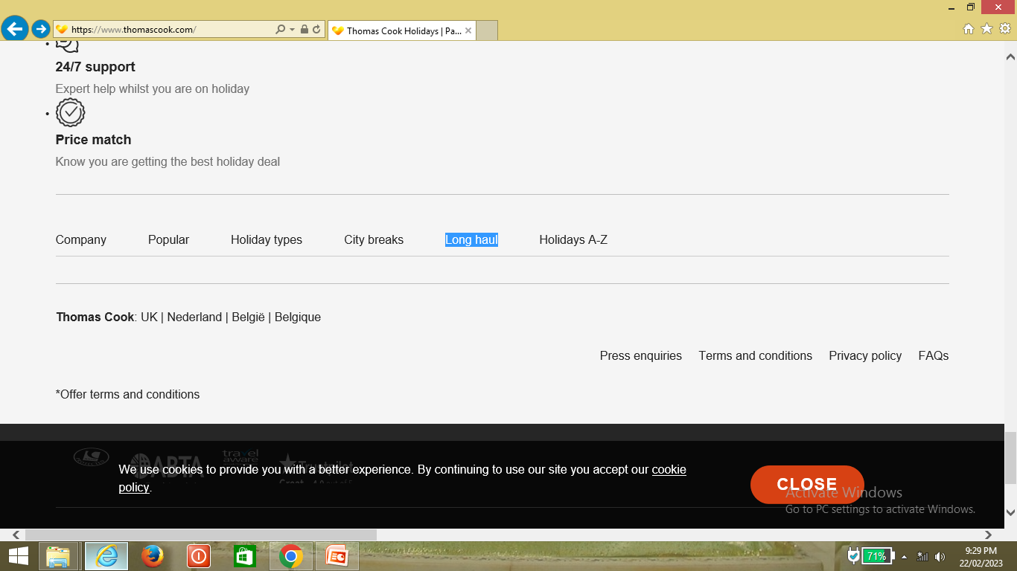
Laptop Browser:- Chrome & Internet Explorer
Chorme
Internet Explorer

Slide 11
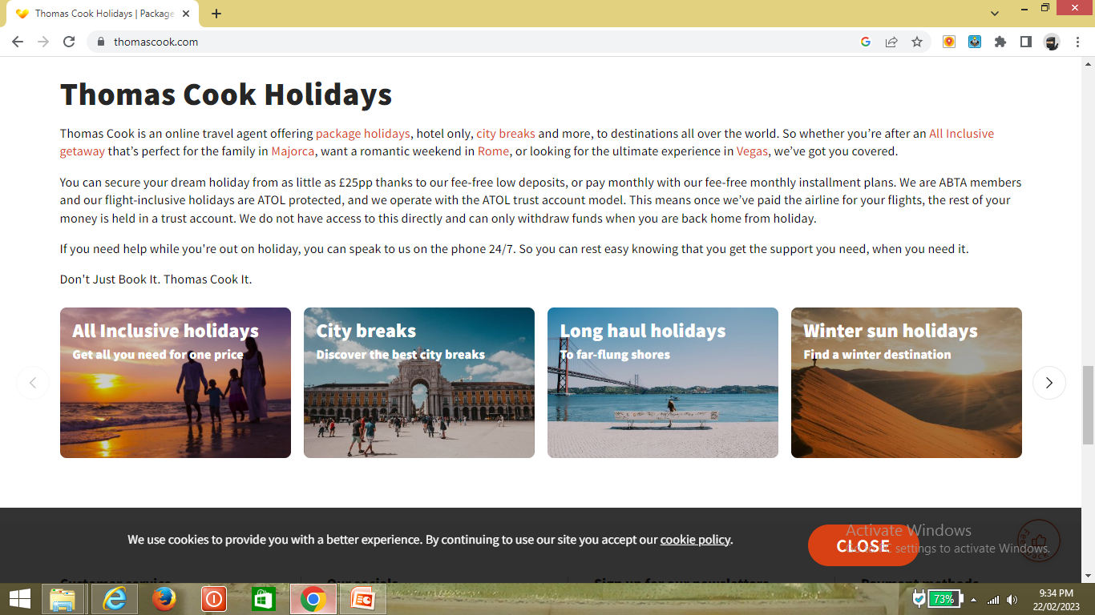
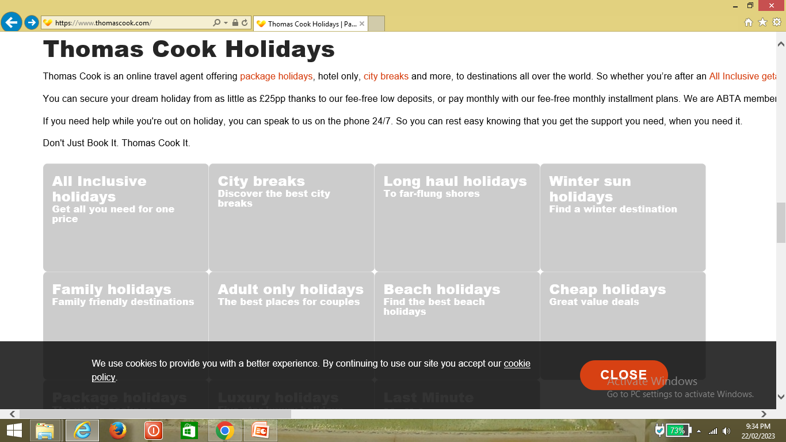
Laptop Browser:- Chrome & Internet Explorer
Chorme
Internet Explorer

Slide 12
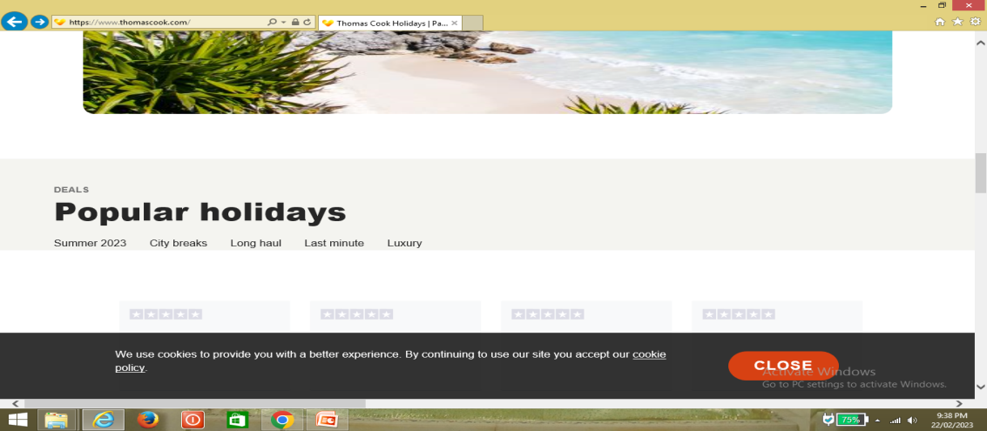
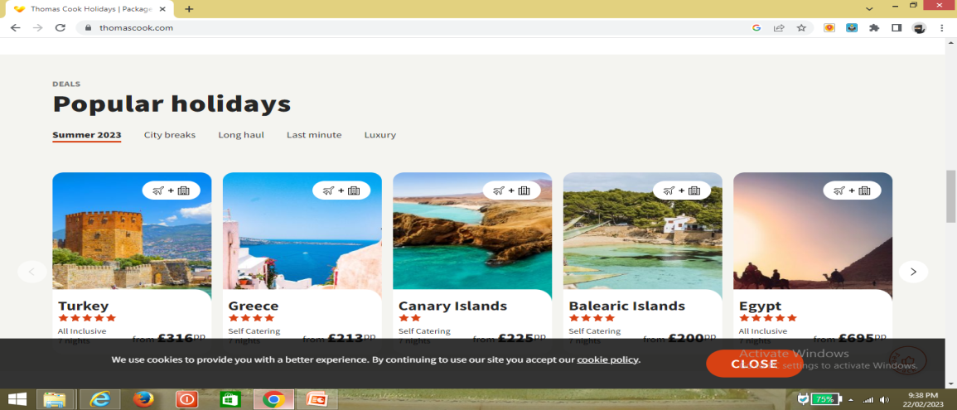
Laptop Browser:- Chrome & Internet Explorer
Chorme
Internet Explorer

